Slide 1
ECE 826
Lecture 1
Theoretical Foundations of Large-scale Machine Learning

Slide 2
Intros
Instructor
Dimitris Papailiopoulos
dimitris@papail.io dimitris@ece.wisc.edu
Times
Tu. + Thu. @ 9:30 - 10:45pm
Office Hours:
Just send an email,
and we’ll arrange a mutually convenient time.
Webpage:
papail.io/826

Slide 3
Material
The course is based on recent books and text on ML, OPT, statistics, and systems
Everything online:
papail.io/826
Books
Papers
Lecture Notes
Slides

Slide 4
Overview
Why Machine Learning?
Why Large-Scale?
Where does Optimization fit in?
What we will cover?
Who is this class for?
Grading

Slide 5
Why Machine Learning?

Slide 6
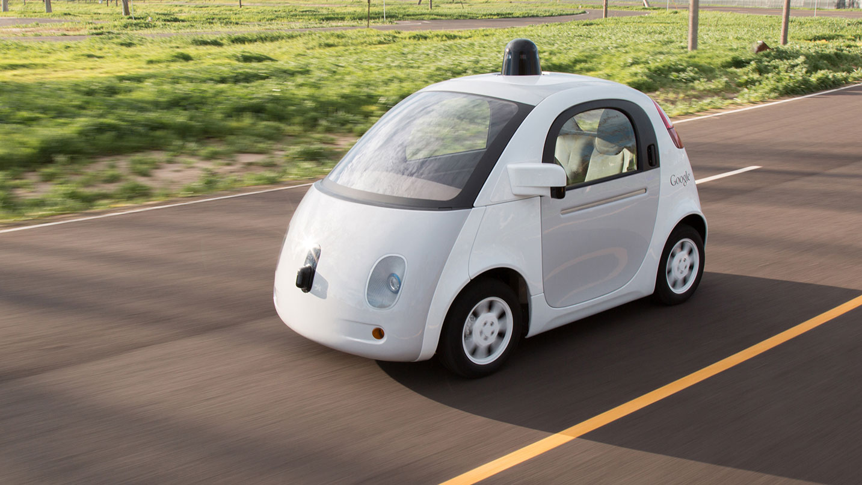
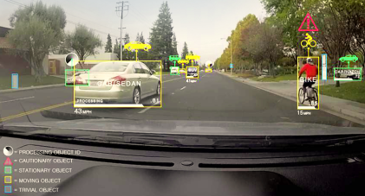
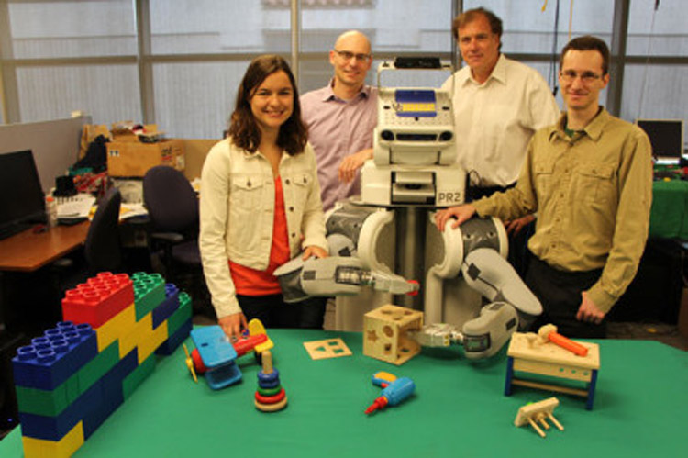
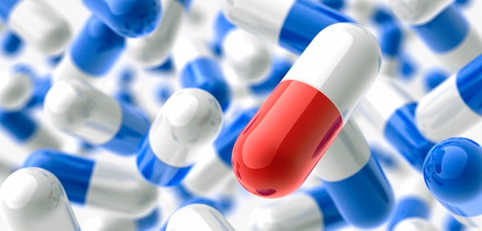
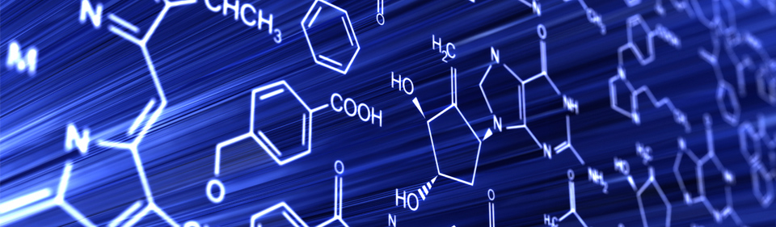
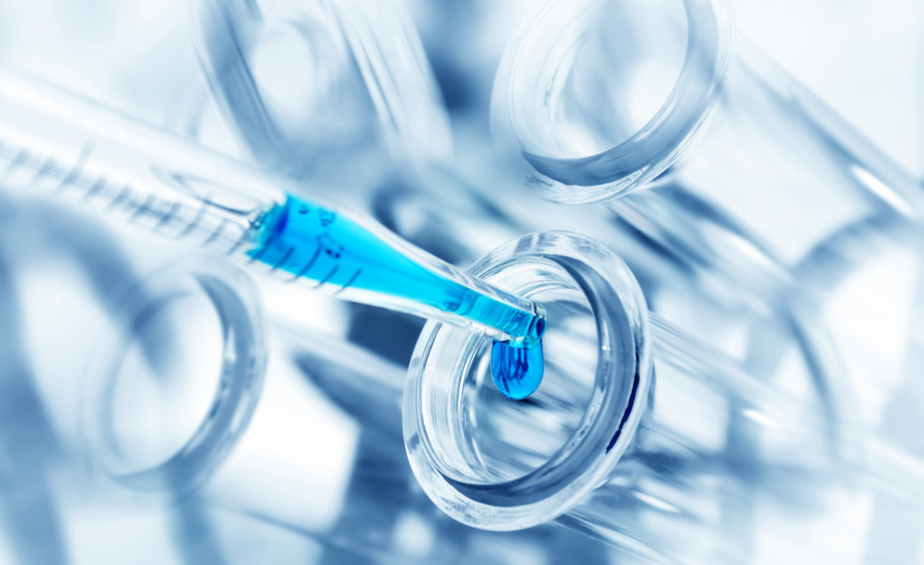
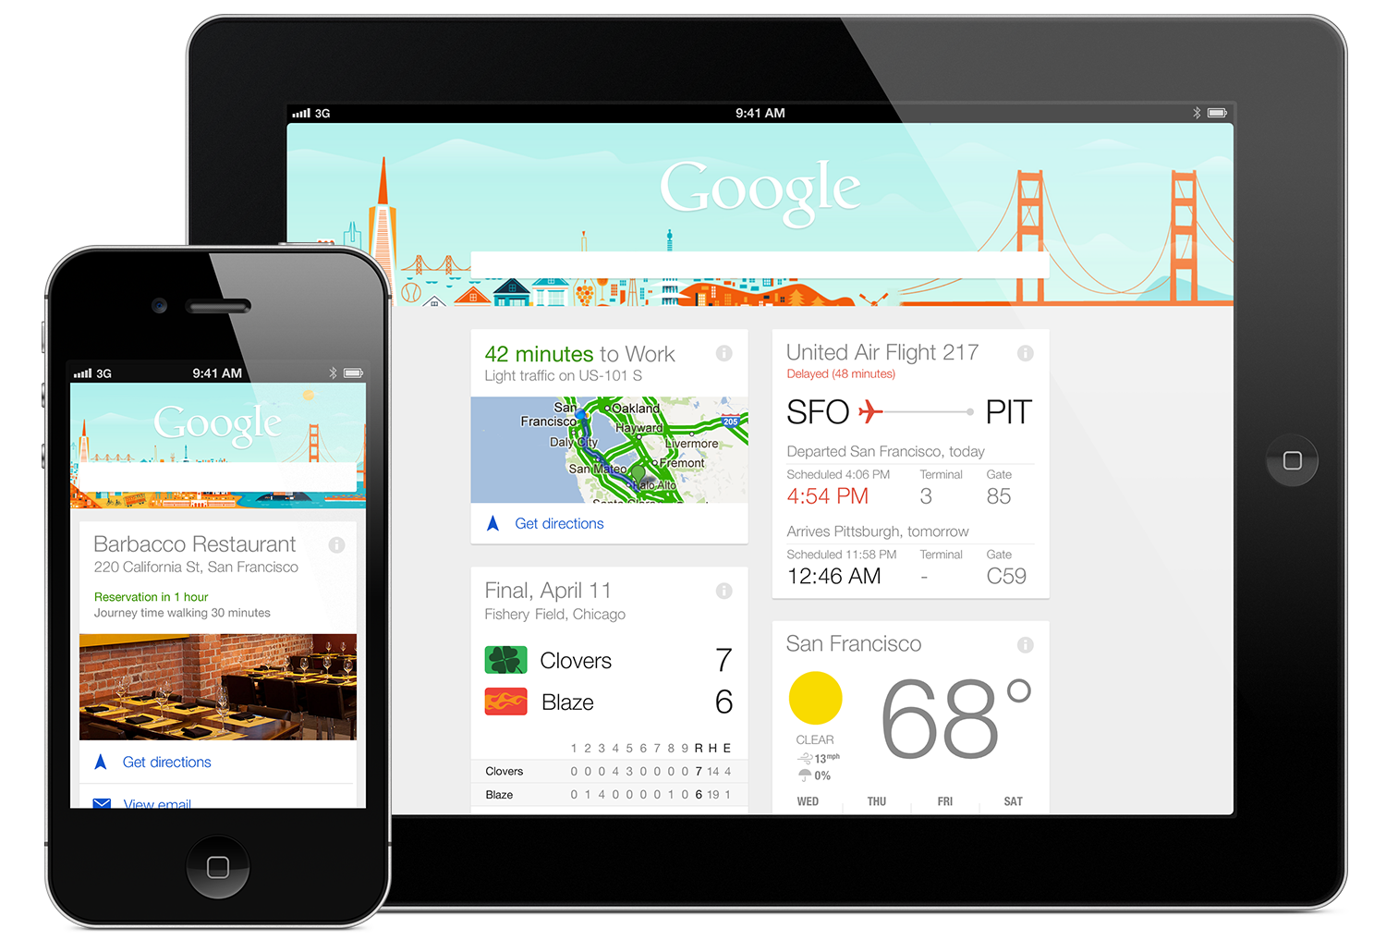
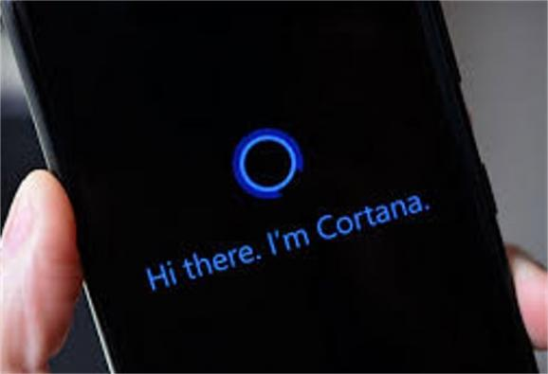
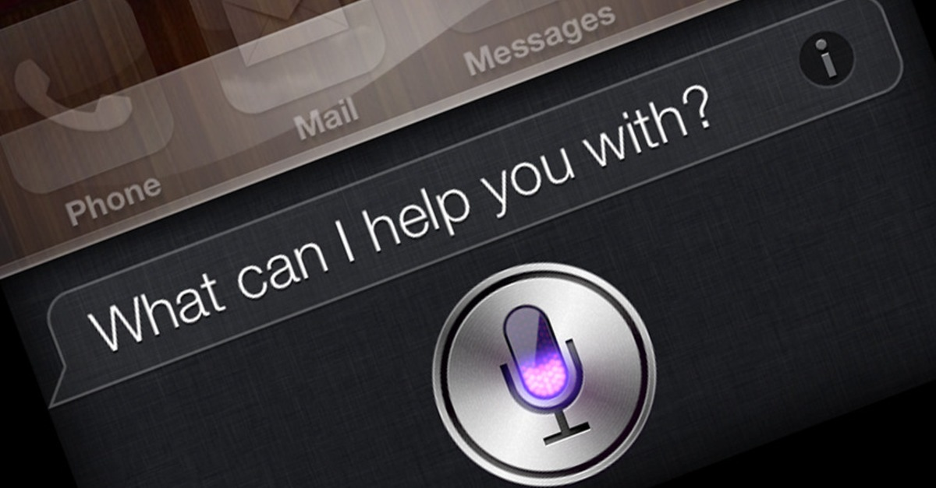


Automation and Robotics
Drug Discovery and Healthcare
Real and Important Problems
Intelligent Personal Assistants
Recommender Systems

Slide 7








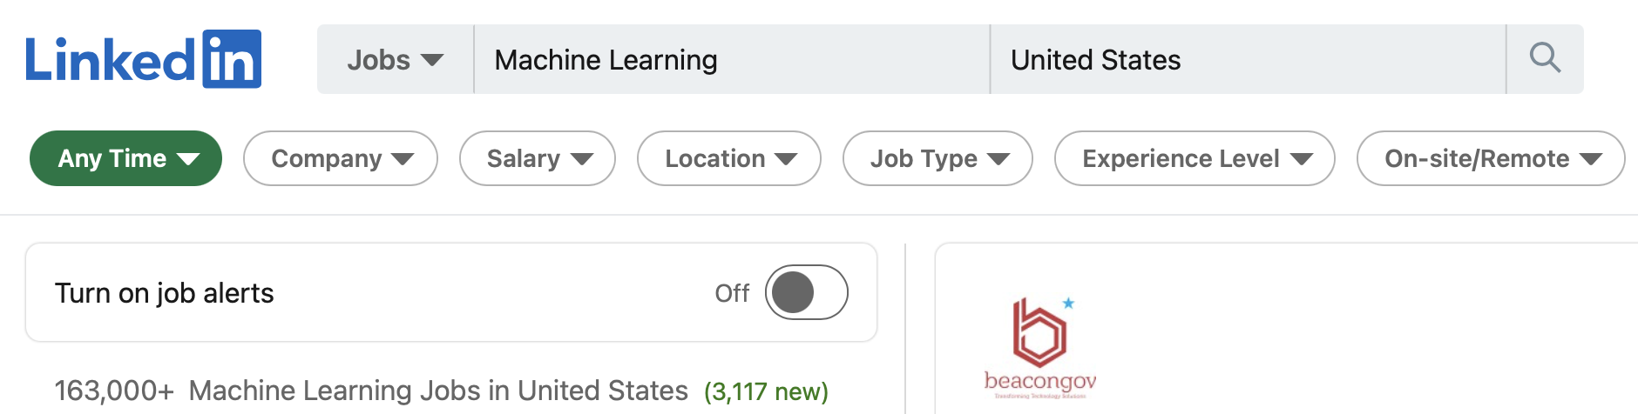
Real Jobs
Taken in 2016
Taken in 2022

Slide 8
Why Large-scale?

Slide 9
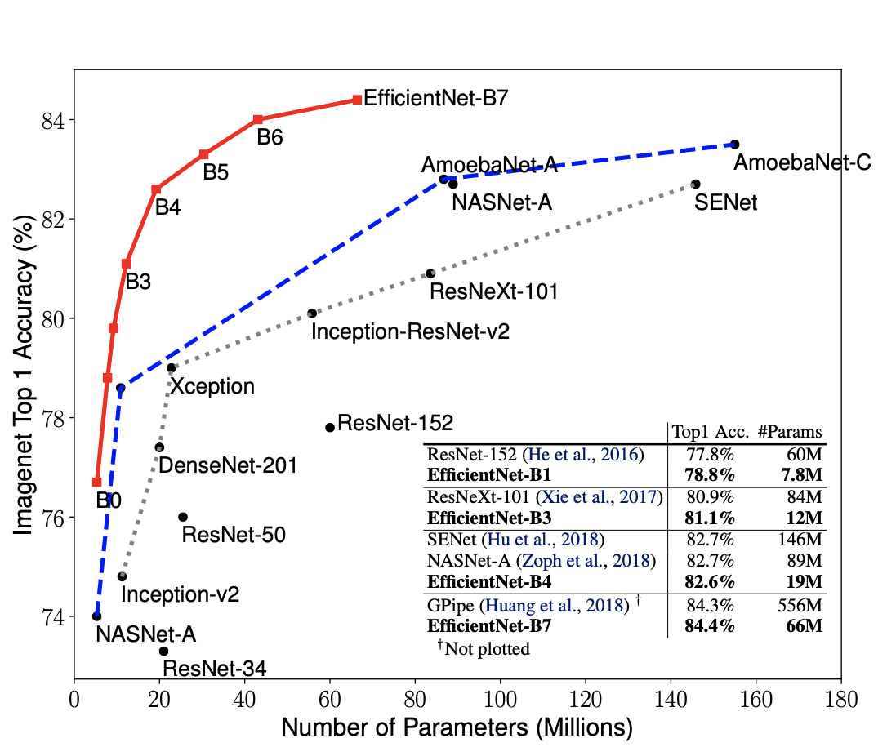
Model sizes (vision)
~0.5GB of parameters
Q: is 0.5GB that large to cause a bottleneck?
A: When training we compute gradients on B data points = B*model size RAM required
[Source: http://proceedings.mlr.press/v97/tan19a/tan19a.pdf]

Slide 10
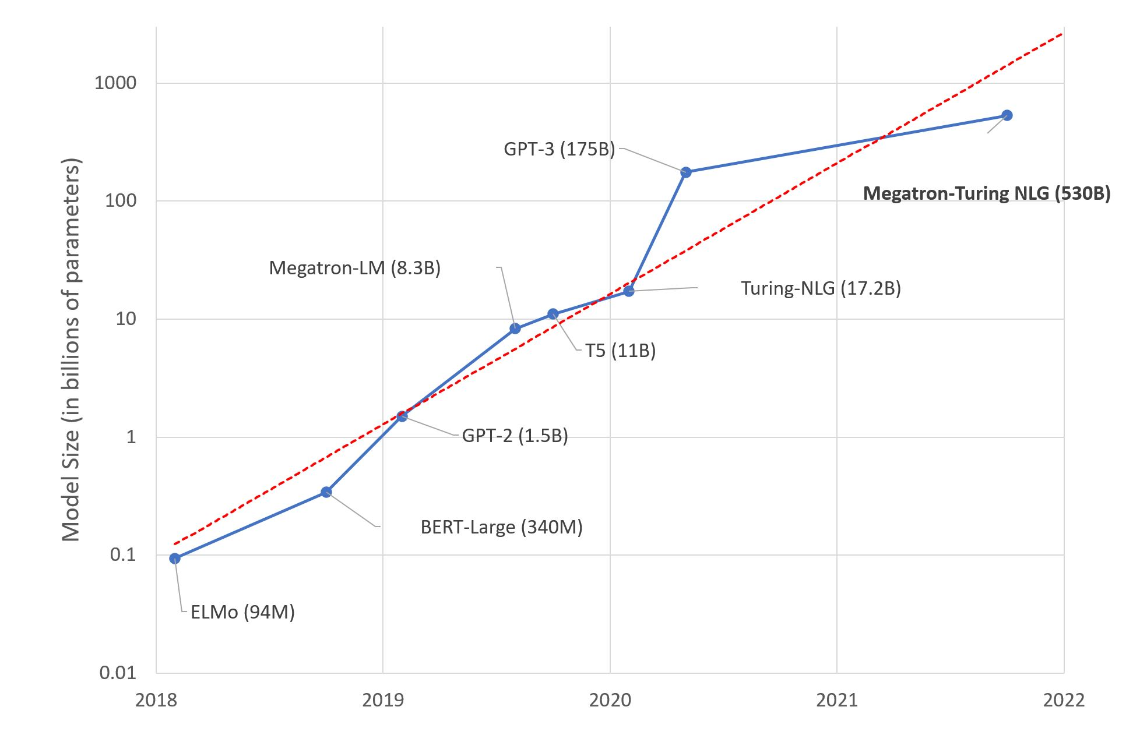
Model sizes (language)
~1TB of parameters
[Source: https://tinyurl.com/Megatron-Turing-NLG]

Slide 11
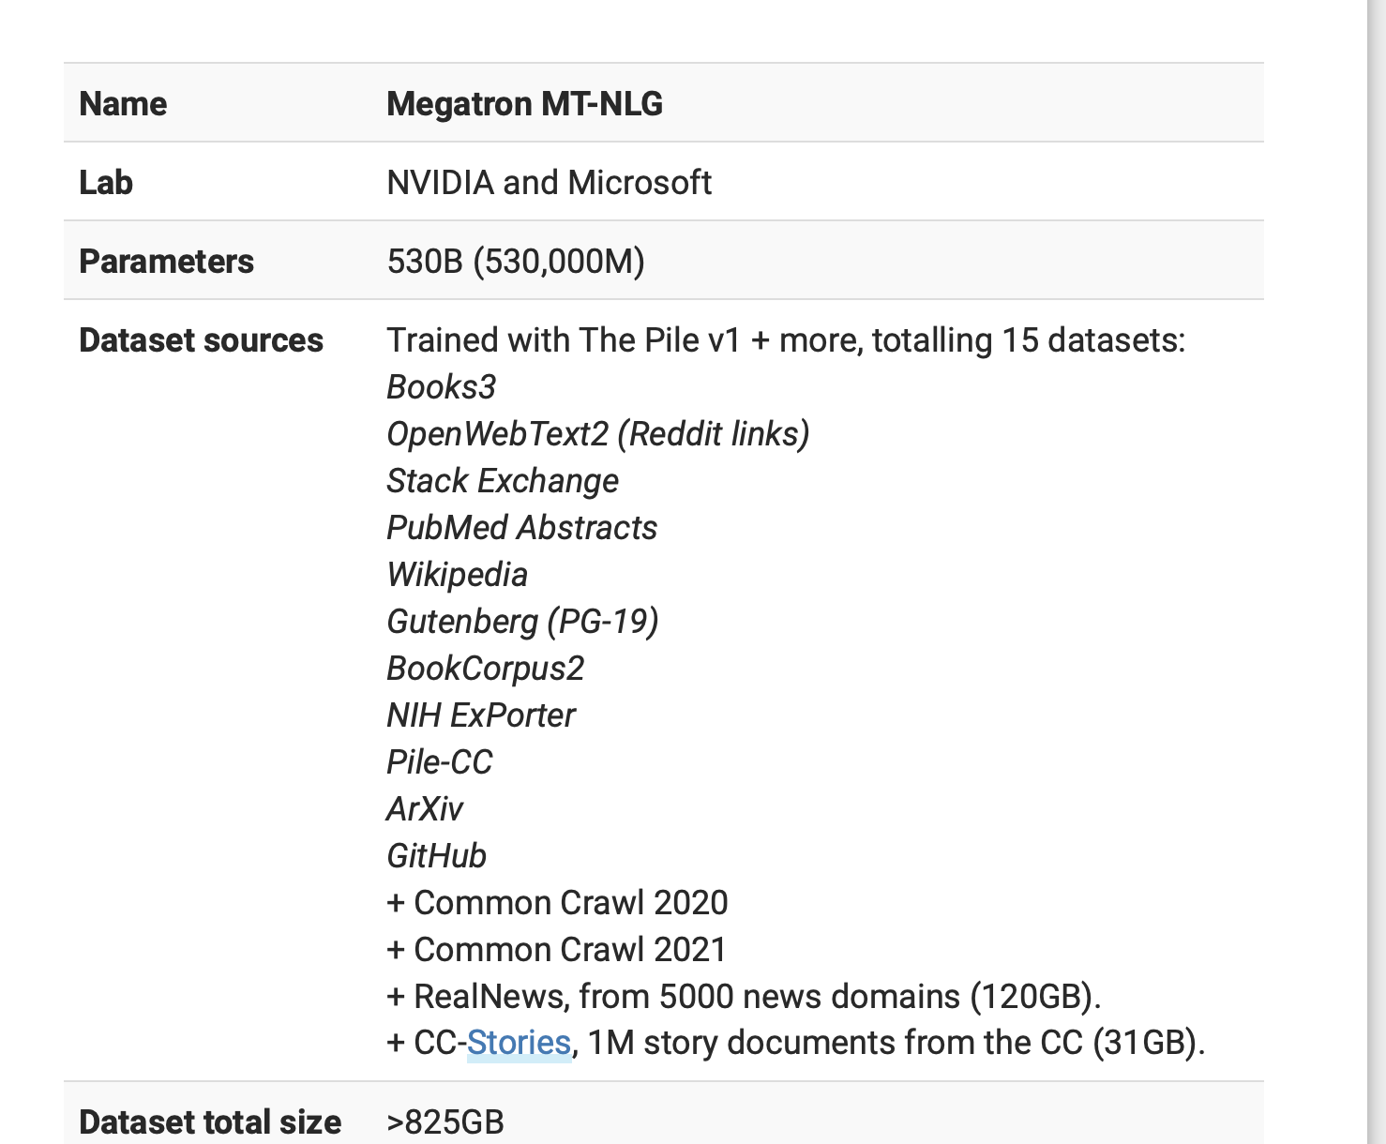
Data set sizes
(ILSVRC) 1.2 mil 256 x 256 images = 150 GB
We need to train huge models on enormous data sets
[Source: https://www.image-net.org, https://lifearchitect.ai/megatron/ ]

Slide 12
Let’s unpack things a bit
Small Detour
The Machine Learning Pipeline

Slide 13

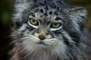
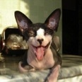



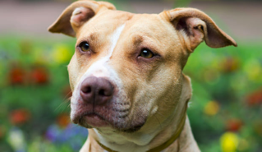
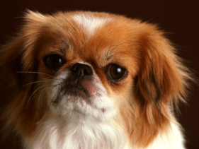

What is a “regular” ML pipeline?
Running example: image classification
Goal:
“train a computer to recognize a cat from a dog”

Slide 14
What is a “regular” ML pipeline?
Running example: image classification
Goal:
“train a computer to recognize a cat from a dog”
How?

Slide 15
What is a “regular” ML pipeline?
Running example: image classification
Goal:
“train a computer to recognize a cat from a dog”
How?
Simple idea, inspired by inductive human learning
Show it a lot of labeled examples
predictions of labels on unseen data

Slide 16
To this
From This

Slide 17
What is a “regular” ML pipeline?
Running example: image classification
Goal:
“train a computer to recognize a cat from a dog”
How?
Input Data

Slide 18
What is a “regular” ML pipeline?
Running example: image classification
Goal:
“train a computer to recognize a cat from a dog”
How?
Input Data
Training

Slide 19
What is a “regular” ML pipeline?
Running example: image classification
Goal:
“train a computer to recognize a cat from a dog”
How?
Input Data
Training
Model

Slide 20
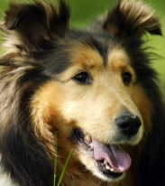
What is a “regular” ML pipeline?
Running example: image classification
Goal:
“train a computer to recognize a cat from a dog”
How?
Test (unseen) Data
Input Data
Training
Model
predicted
label:
“dog”

Slide 21
ML Pipelines
Test Data
Input Data
Data Preparation/ Model selection
Training
Model

Slide 22
ML Pipelines
Test Data
Input Data
Data Preparation/ Model selection
Training
Model

Slide 23
Data Preparation
Data cleaning
Data normalization
Handling missing/noisy data/outliers
Removal of unwanted features
Putting in the appropriate format
Data Augmentation
Goal: Make the most out of your data

Slide 24
Choose your predictor
(hypothesis class)
Almost always the answer is some kind of a NN architecture
(ResNets, Transformers, etc)
Goal: Pick a predictor that
1) Is expressive 2) is easy to train 3) doesn’t overfit

Slide 25
ML Pipelines
Test Data
Input Data
Data Preparation/ Model selection
Training
Model

Slide 26
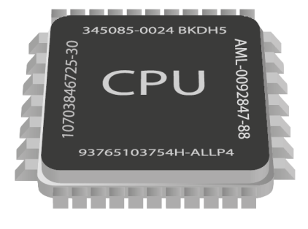
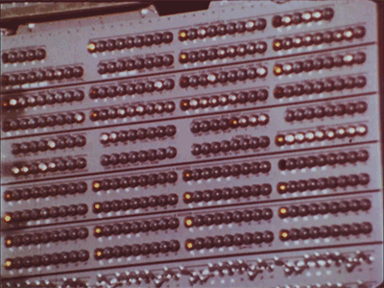
Now we train
Goal: Train a model to minimizes training error
Line = predictive model (classifier)
Ear Length
Snout Length

Slide 27

ML Pipelines
Test Data
Input Data
Feature Selection
Training
Model
GPT-3 would take 288 years to train on a single Tesla V100 GPU
[source: https://arxiv.org/pdf/2104.04473.pdf]

Slide 28
Questions?

Slide 29
What is the role of Optimization?

Slide 30
Training via Optimization
Many Problems in ML can be written as
Why?

Slide 31
The goal of Training
What we have: Labeled examples presented as (features, label)
E.g., features = image, label = “cat” (-1), or “dog” (+1)
Assumption:
all labeled (train/test) examples come from unknown distribution
+1

Slide 32
The goal of Training
What we have: n labeled examples drawn i.i.d. from
What we want: Train a model (a predictor function f )
That performs well on unseen data.

Slide 33
The goal of Training
What we have: n labeled examples drawn i.i.d. from
What we want: Train a model (a predictor function f )
That performs well on unseen data.
E.g.,
Our trained predictor

Slide 34
The goal of Training
How to measure performance?
Goal:
We want a predictor f with small loss on unseen data (e.g., on the test set)
Examples:
Cross entropy
Logistic loss
Measures disagreement between
predicted and true label
But, we haven’t seen… unseen examples

Slide 35
The goal of Training
The loss on the “unseen” examples converges to the expected loss
What else converges to the expected loss?
Note: More details in next lecture
Expected/True risk
Empirical risk

Slide 36
Training via Optimization
We want to solve:
We instead solve the ERM:
Note: More details in next lecture
Generalization is another great mystery, we will come back to soon
e.g., F can be:
separating hyperplanes
NNs of depth-t
…

Slide 37
Training via Optimization
More often than not, we minimize the empirical risk through
Note: Several examples in next lectures.
Measures model fit
for data point i
(avoids under-fitting)
Measures model
“complexity”
(enhances generalization)

Slide 38
Questions?

Slide 39
Scalability & System Aspects

Slide 40
Solvability ≠ Scalability
Some of the problems that we visit, can be solved in polynomial time, but that’s not enough.
E.g.,
O( #examples^4 * dimension^5 ) not scalable
We need fast algorithms!
Ideally O(#examples * #dimension) time
We want algorithms amenable to parallelization!
if serial runs in O(T) time, we want O(T/P) on P cores.

Slide 41
Reality ~100x worse than optimal
Optimal Speed-up
WHY?
“Large Scale Distributed Deep Networks” [Dean et al., NIPS 2012]

Slide 42
Performance Trade-off
We want our algorithms & models to be here
stat. accuracy
How?
By using both theory and practice to guide our design
speed
scalability

Slide 43
We want even more from a model

Slide 44
Moar!
Robustness to attacks/hardware failures
Low Memory footprint
Easy to store
Fast to do Inference on
Easy to Personalize to individual users
…

Slide 45
Contents and Goals

Slide 46
This course
Algorithms / Optimization
Statistics
Systems

Slide 47
What will we cover?
Part 1: (~6 weeks) (ML+OPT theory)
When does a classifier generalize/why?
Memorization bounds for NNs
Generalization through Algorithmic Stability
Stochastic Optimization for Convex/Nonconvex Problems
Optimizing Neural Nets, Hardness, Expressivity, Recent results
Part 2: (~ 6 weeks) (large-scale ML practical aspects)
Distributed/Parallel Learning
Federated/Decentralized Learning
Model & Gradient Compression/Quantization/Low precision
Sparse Updates and the Lottery Ticket Hypothesis
Dealing with worst-case Failures (Delays, Adversaries)
Modern Architectures: ResNets, Vision/Language Transformers, etc

Slide 48
What we won’t cover
Unsupervised Learning/RL/Generative Models
Tensorflow/PyTorch
How to train Imagenet in 1hr
How to tune the batchnorm layers of ResNet-101
Building the next Vision Transformer

Slide 49
Goals of this course
Learn useful theoretical tools and current trends
for large-scale ML
Produce a research-quality project report

Slide 50
Questions?

Slide 51
Grading Logistics

Slide 52
Grading
No Written Exams

Slide 53
Grading
1. Research Project – 60%
Homework – 20%
Scribing – 10%
Student Participation – 10%

Slide 54
Semester Project (60%)
Milestones:
Part 1: (20%)
Mid-semester proposal (due ~week #9)
Proposal presentation and feedback day.
Part 2: (40%)
End-semester report (due May 5)
During the semester:
Weekly Slack updates, starting after the proposal
What can it be?
An open problem directly relevant to the course.

Slide 55
Homework (20%)
Frequency:
Every ~3 weeks
starting ~ week 4
Total of ~3
Content:
Exercises related to the class
Paper reviews
Some implementation component

Slide 56
Scribing (10%)
Frequency:
Every lecture starting lecture #2
Due 1 week after each lecture
Format:
Groups of #students / #lectures
One group / lecture
(everyone has to scribe once)
LaTeX template

Slide 57
Student Participation (10%)
Students expected to participate with questions, and comments.
Small project updates during semester.
Meet with instructor before project proposal
Other in-class activities.

Slide 58
Grading
1. Research Project – 60%
Homework – 20%
Scribing – 10%
Student Participation – 10%

Slide 59
Pre-Reqs
Linear Algebra
Probability
Grad course in ML

Slide 60
Questions?

Slide 61
Quiz

